Slide 1
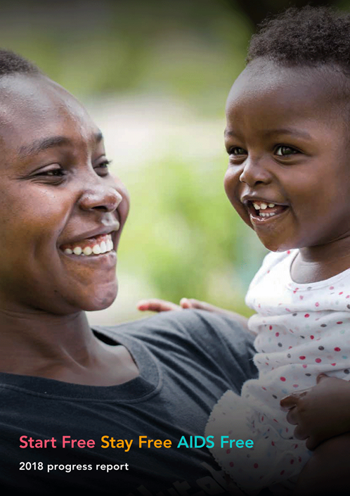
Start Free, Stay Free, AIDS Free
Progress report 2019

Slide 2
Start free – Super fast track
Start Free aims to end new HIV infections among children by -- among other actions -- reaching 95% of pregnant women living with HIV and sustaining them on lifelong antiretroviral therapy by 2018
PMTCT Progress, Globally (coverage of HIV+ pregnant women)
2010: 44% 2018: 82%
2015: 80%

Slide 3
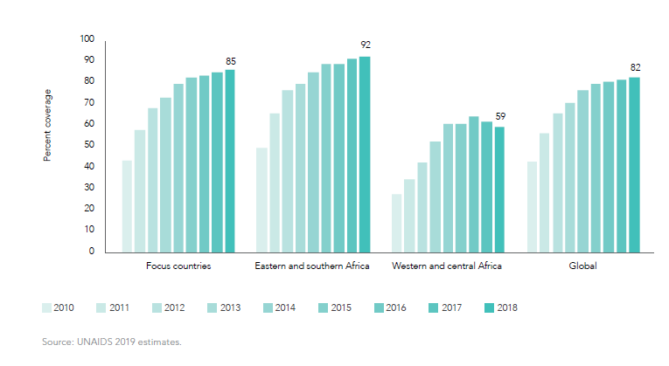
Good progress between 2010 and 2015 but plateauing in last few years
Coverage of ARVs among pregnant women, by region 2010-2018

Slide 4
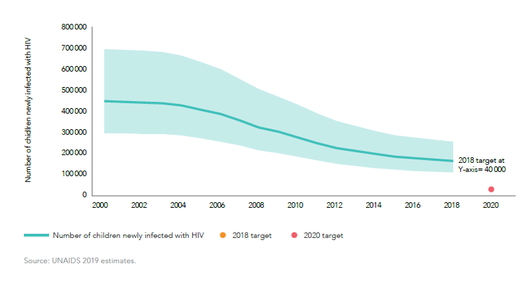
As a result new child HIV infections are no longer declining at the same rate
New child HIV infections, globally, 2010-2018
240,000 in 2010
160,000 in 2018
Target: 40,000 in 2018

Slide 5
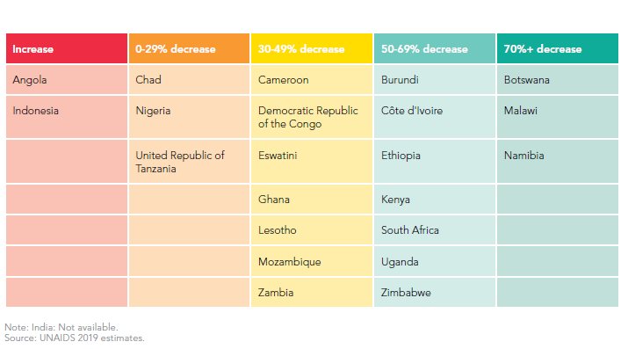
Impressive achievements in some countries, such as, Botswana, Malawi and Namibia
Percent decline in new child infections 2010 to 2018, 22 focus countries
Notes:
Great progress in some

Slide 6
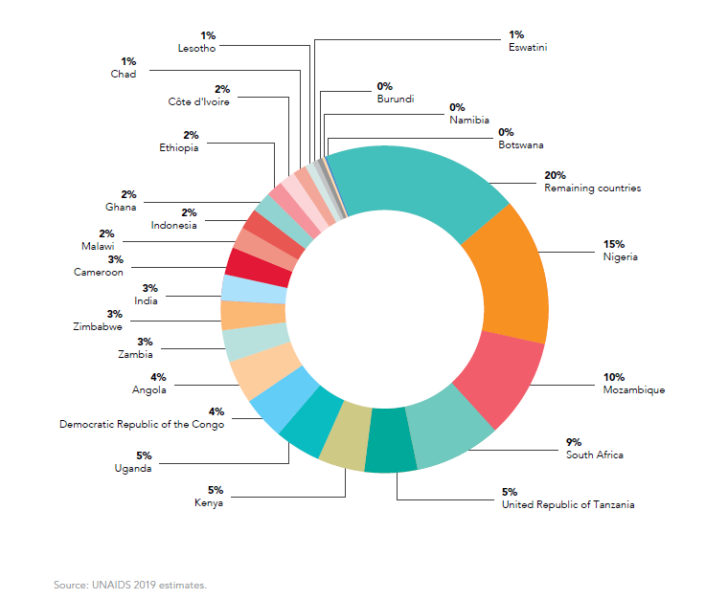
Learn from those success stories and focus! Among the 23 focus countries, half of new child infections are in Mozambique, Nigeria, and South Africa
Distribution of new child HIV infections, 23 focus countries and remaining countries, 2018

Slide 7
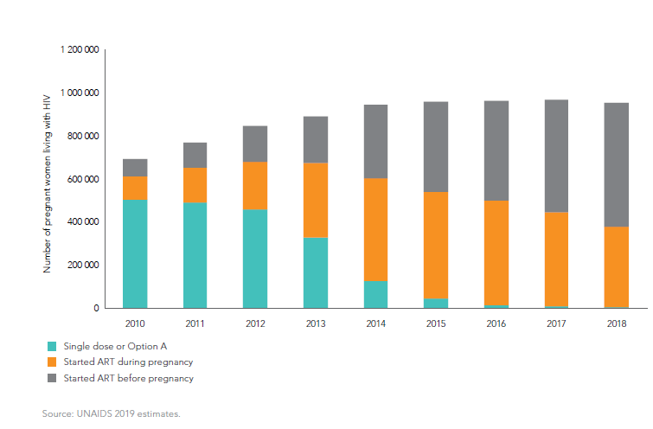
Good progress on moving women to lifelong treatment, although over 40% are still only starting ART at first ANC
Numbers of pregnant women receiving ARVs by regimen and timing of start of ARVs, 23 focus countries, 2010-2018

Slide 8
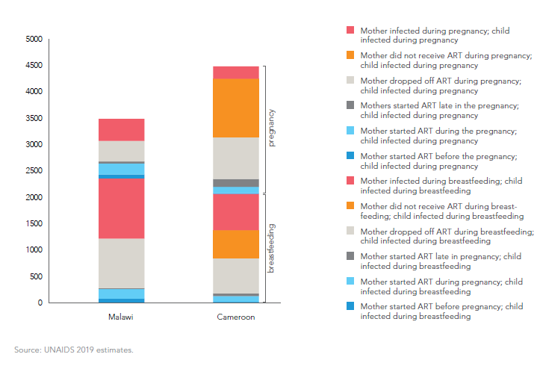
Which gaps lead to most new child infections differ-- by program and over time: target solutions!
Distribution of new child HIV infections by service for preventing vertical transmission of HIV, Cameroon and Malawi, 2018

Slide 9
Stay free
Stay Free focuses on reducing the number of adolescent girls and young women aged 10-24 years acquiring HIV to fewer than 100 000 annually by 2020
New infections, AGYW 10-24yrs, Globally
2010: 420,000 2018: 310,000
2015: 350,000

Slide 10
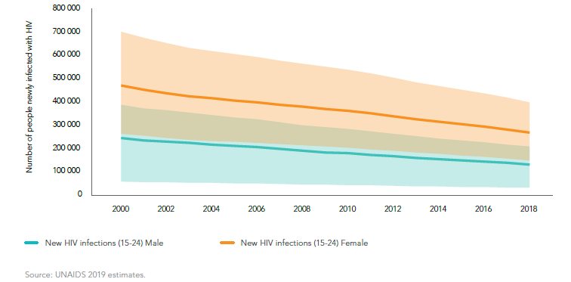
Promising declines among young women but still considerably higher than young men
New HIV Infections among young women and young men, 23 focus countries, 2010-2018

Slide 11
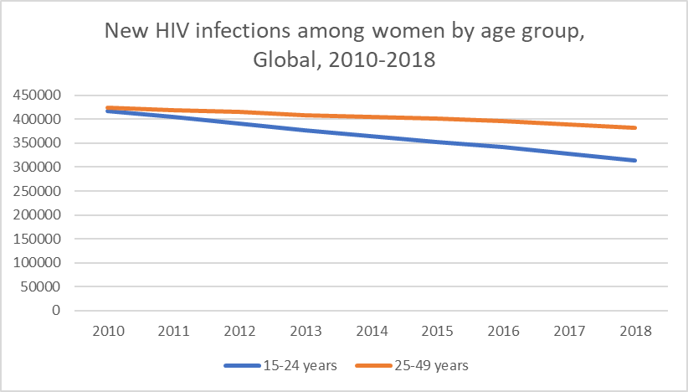
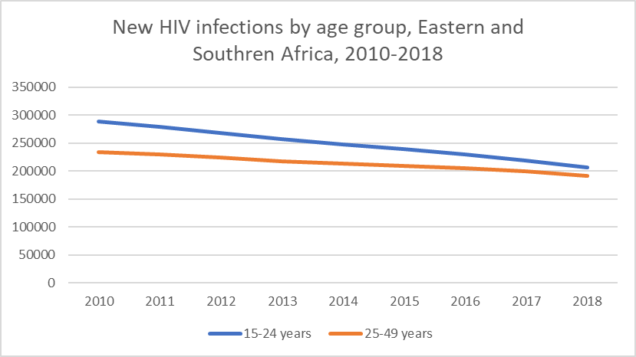
Steeper declines in new HIV infections among young women (15-24) than older women (25-49)
-10%
-28%
-25%
-18%

Slide 12
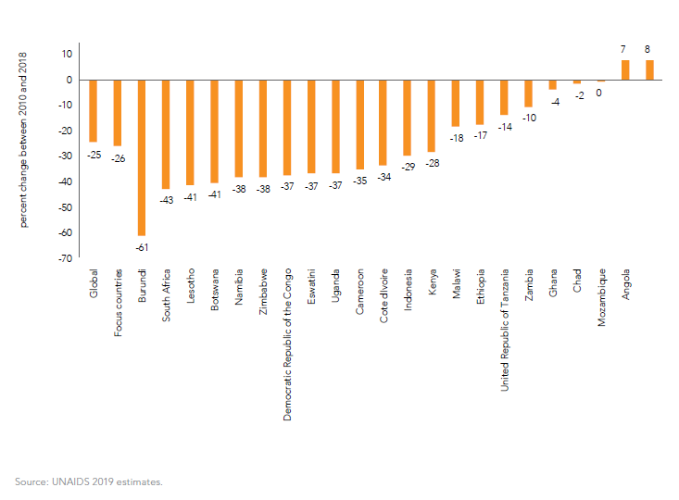
But, declines in new HIV infections among young women are happening consistently across countries
Percent change between 2010 and 2018 in new infections among young women 15-24, 22 focus countries

Slide 13
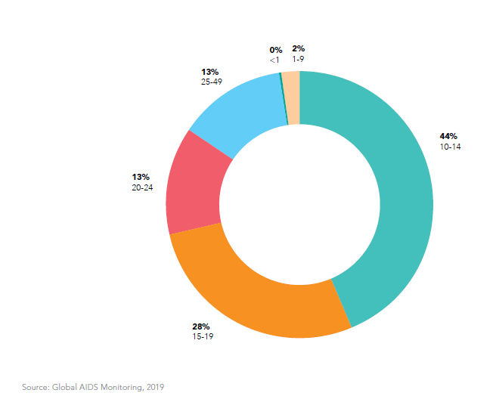
4.1 million male circumcisions in 2018 but 44% were among boys aged 10-14 years
Distribution of male circumcisions by age, 12 countries with available data, 2018
Need at least 5 million circumcisions per year to reach global targets

Slide 14
AIDS free – Super fast track
AIDS Free seeks to ensure that 95% of all children and adolescents aged 10-19 years living with HIV receive antiretroviral therapy by 2020.
(Or 1.6 million by 2018 and 1.4 million by 2020)
Child Treatment, 10-19 yr olds, Globally
2010: 430,000 (20% tx coverage vs 25% in adults)
2015: 845,000 (45% tx coverage vs 48% in adults)
2018: 940,000 (54% tx coverage vs 62% For adults)

Slide 15
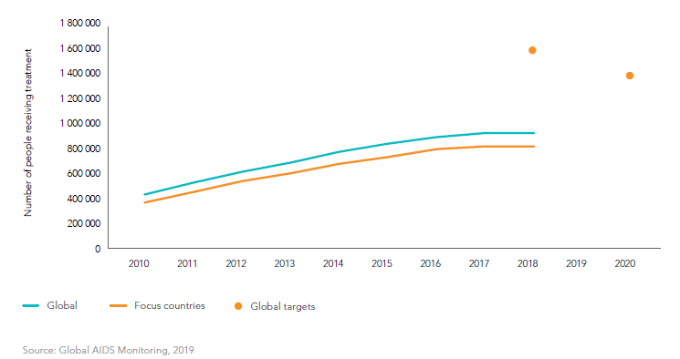
Scale up of treatment for children is slowing: New, innovative modalities to identify CLHIV are needed
Number of children receiving ART and targets, global and 23 focus countries 2010-2018

Slide 16
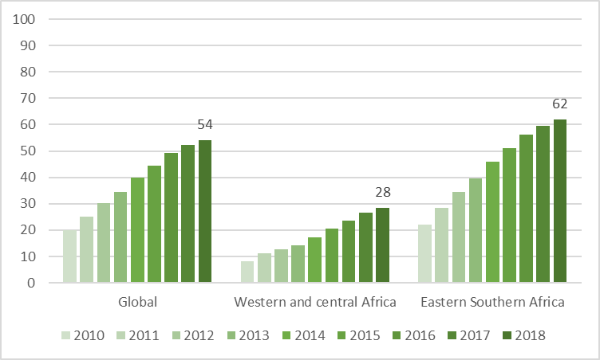
Similar to PMTCT coverage, paediatric ART scale up is particularly poor in western central Africa
ART coverage among children, by region, 2010-2018

Slide 17
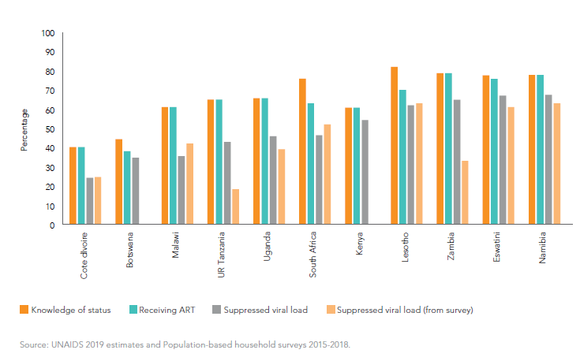
Treatment cascades from programmes show challenges with viral load suppression among children confirmed by survey data
Treatment cascade and viral suppression from survey, by countries with available data, 2018

Slide 18
So now what???
Over to chairs of the Start Free, Stay Free and AIDS Free subgroups

